Slide 1
Logic Synthesis toolbox

Slide 2
Lecutre-3 Logic network representation

Slide 3
Table of Contents
Homogeneous network
And-Inverter Graph
Majority-Inverter Graph
Heterogeneous network
Klut Graph
Block Graph
Network utility functions
Notes:
Riener, Heinz, et al. "Scalable generic logic synthesis: One approach to rule them all."

Slide 4
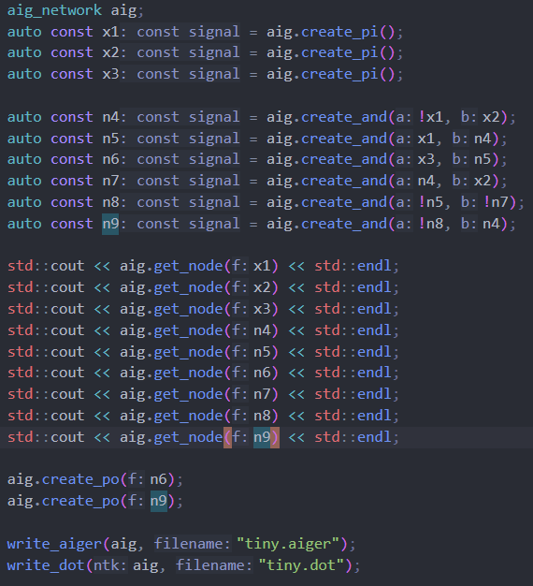

AIG Network
Node
Index
Gate
Signal

Slide 5
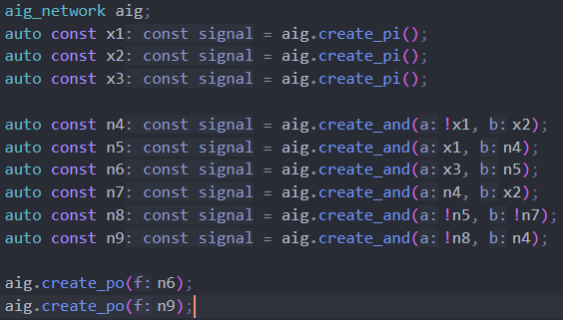
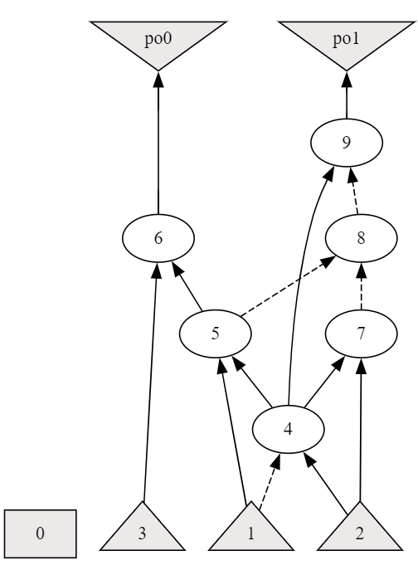
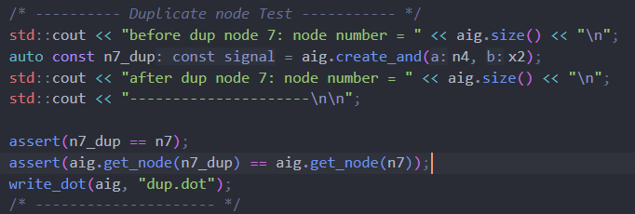


Slide 6
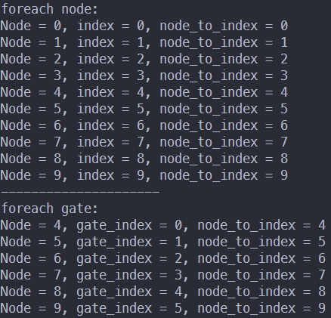
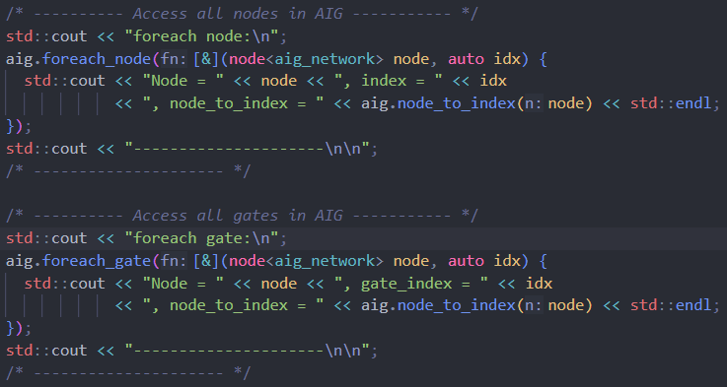
AIG Network
Node
Index
Gate
Signal
More network related API: https://mockturtle.readthedocs.io/en/latest/implementations.html

Slide 7
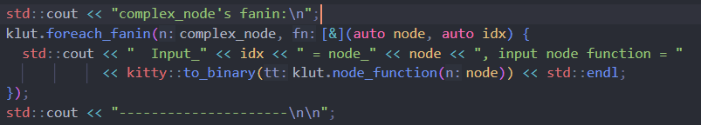
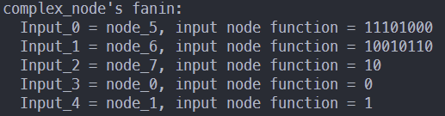
klut_network

Slide 8
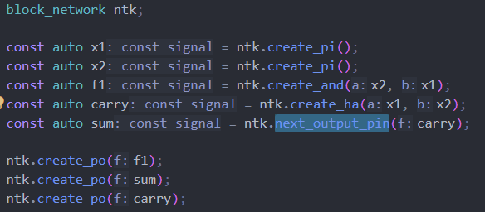
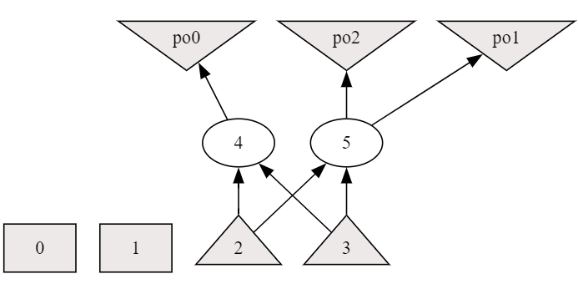
block_network

Slide 9
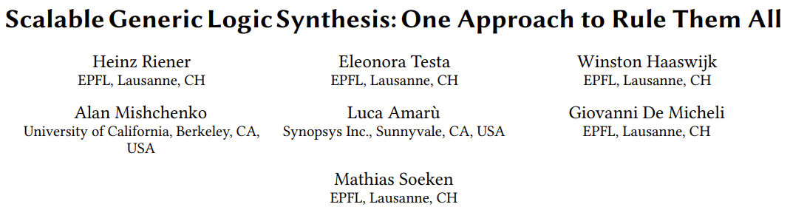
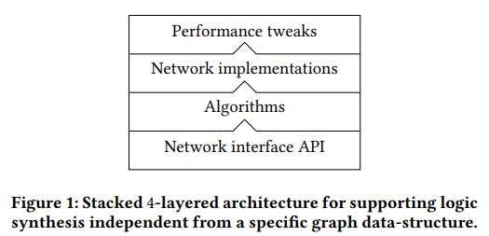
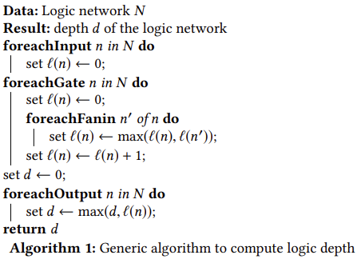

Slide 10
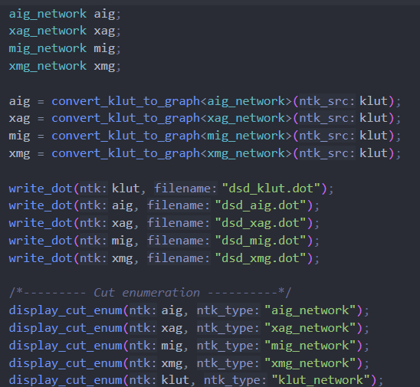
Generic algorithm in Mockturtle

Slide 11
Reference
Soeken, Mathias, et al. "The EPFL logic synthesis libraries." arXiv preprint arXiv:1805.05121 (2018).
Riener, Heinz, et al. "Scalable generic logic synthesis: One approach to rule them all." Proceedings of the 56th Annual Design Automation Conference 2019. 2019.
Mockturtle doc

